Slide 1
Next Level Ag Labs: Analysis Packages

Slide 2
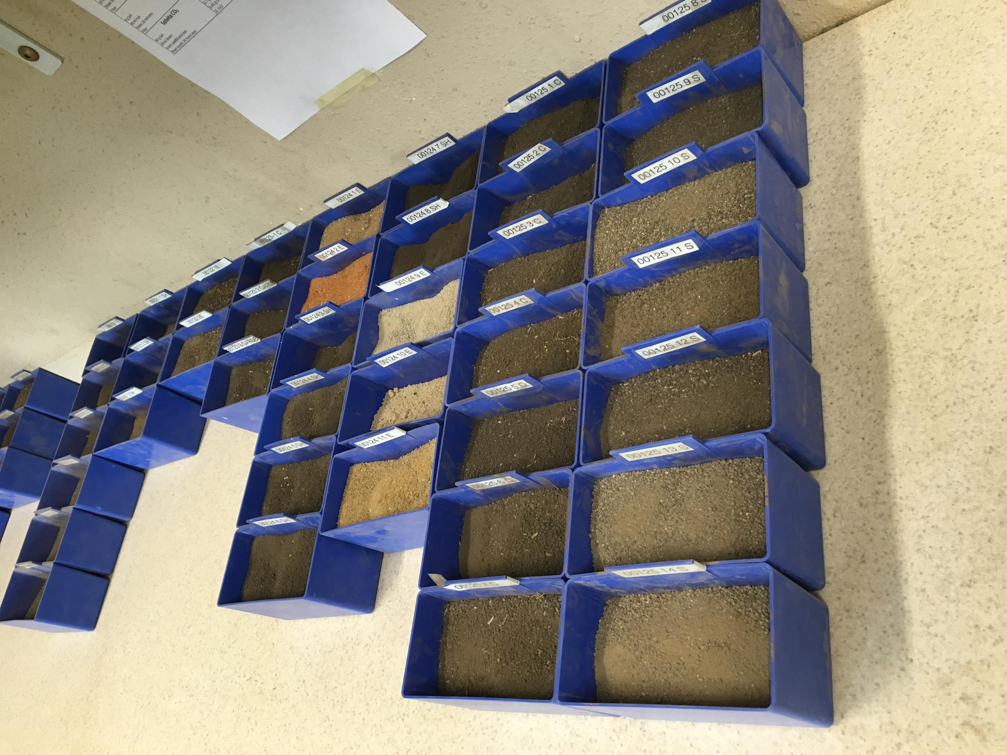
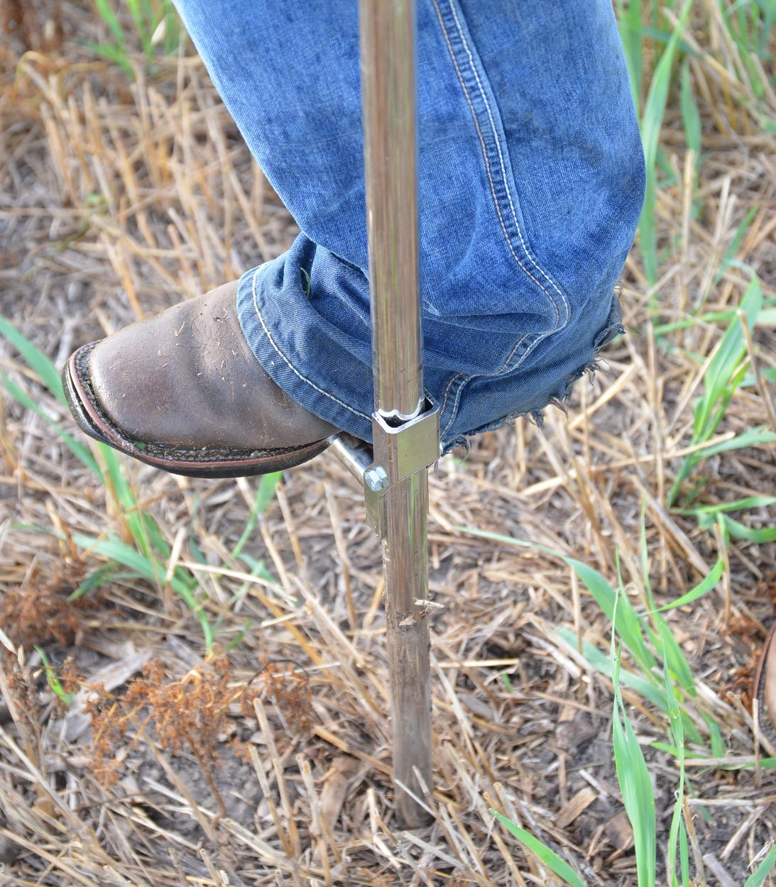
Test Packages
Indicator
Essential
Mehlich
Custom

Slide 3
Essential Test Package: $25
University Standard Test – OM, Nitrate, P, K, Ca, Mg, Zn, Mn, Fe, Cu, B, Na, pH, Buffer pH, EC, CEC
Fits Best: Grid sampling, manure management, low intensity fertility program, and composite samples
Pros: Less expensive
Cons: Only gives picture of chemistry side of soil. No physical or biological data provided.

Slide 4
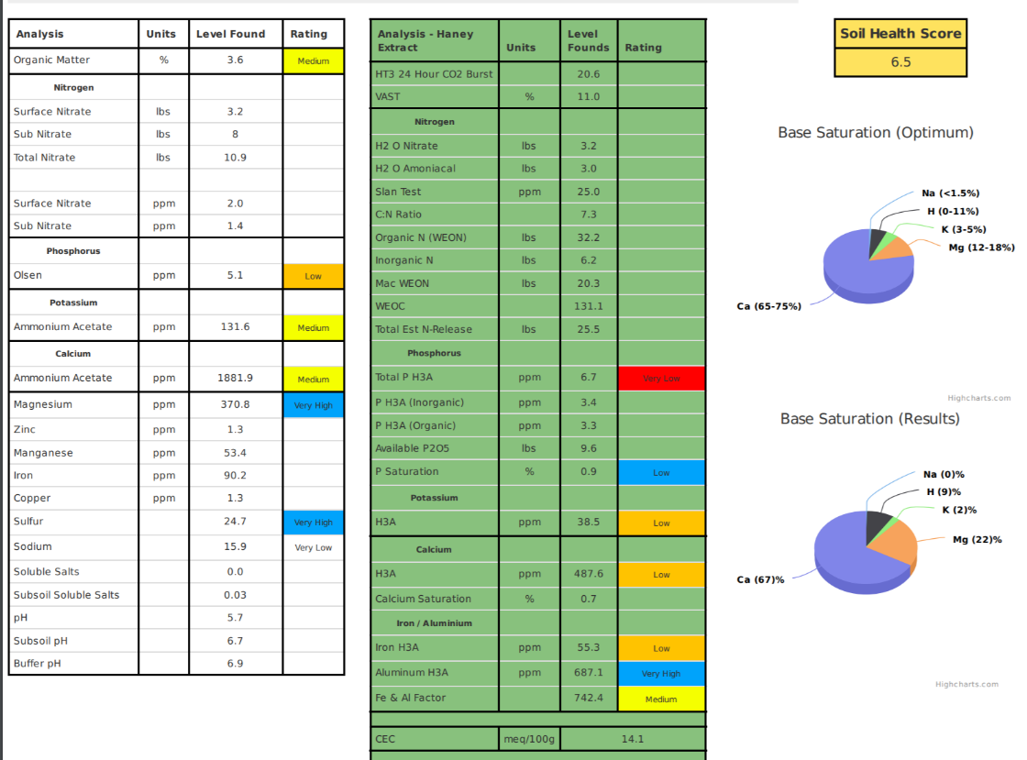
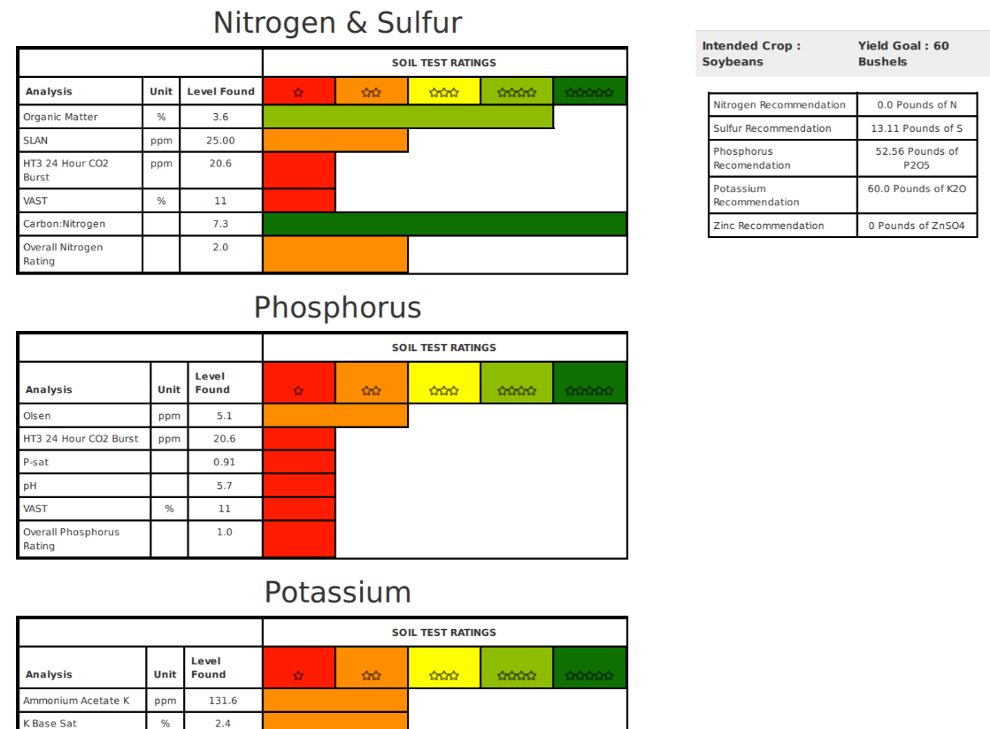
Indicator Test Package: $66
NL Ag Premier Test – Essential plus VAST, SLAN, HT3, Ammoniacal N, Total Organic N, Total Organic Carbon, H3A Extract Package. Also, includes nutrient relationships and soil health score.
Fits Best: Zone management and higher intensity fertility programs
Pros:
Gives a better picture of not only the chemical side of the soil but also the physical and biological side
Plant availability and why
What areas are lacking and what placement methods might fit best
Soil health tracking
Cons:
Higher cost
Need zones to really maximize effectiveness

Slide 5
Mehlich Test Package: $13
All Mehlich Extract - OM, Nitrate, P, K, Ca, Mg, Zn, Mn, Fe, Cu, Na, pH, Buffer pH, EC, CEC
Fits Best: Grids, replacement for the essential test in Low CEC environments
Pro: Less expensive
Cons: Not accurate in higher CEC soils

